Slide 1


Slide 2
Chapter 12 Outline
Overview of Object Database Concepts
Object-Relational Features
Object Database Extensions to SQL
ODMG Object Model and the Object Definition Language ODL
Object Database Conceptual Design
The Object Query Language OQL
Overview of the C++ Language Binding
Slide 12- 2

Slide 3
Object and Object-Relational
Databases
Object databases (ODB)
  Object data management systems (ODMS)
  Meet some of the needs of more complex applications
    CAD, Biological data, GIS, Multimedia
  Specify:
    Structure of complex objects
    Operations that can be applied to these objects
Slide 12- 3

Slide 4
Pros and Cons
Pros
  Use of objects in the database allows for more advanced data storage
  Less of an Impedance mismatch
Cons
  More difficult design
  Switching over takes a lot of work
Slide 8- <number>

Slide 5
Overview of Object Database Concepts
Introduction to object-oriented concepts and features
  Origins in OO programming languages
  Object has two components:
    State (value) and behavior (operations)
  Instance variables (attributes)
    Hold values that define internal state of object
  Operation is defined in two parts:
    Signature (interface) and implementation (method)
Slide 12- 4

Slide 6
Overview of Object Database Concepts (cont’d.)
  Inheritance
    Permits specification of new types or classes that inherit much of their structure and/or operations from previously defined types or classes
  Operator overloading
    Operation’s ability to be applied to different types of objects
    Operation name may refer to several distinct implementations
Slide 12- 5

Slide 7
Object Identity, and Objects versus Literals
Object has Unique identity
  Implemented via a unique, system-generated object identifier (OID)
  Immutable
  Similar to Primary Key
Most OO database systems allow for the representation of both objects and literals (simple or complex values)
Slide 12- 6

Slide 8
Complex Type Structures for Objects and Literals
Structure of arbitrary complexity
  Contain all necessary information that describes object or literal
Nesting type constructors
  Generate complex type from other types
Type constructors (type generators):
  Atom (basic data type – int, string, etc.)
  Struct (or tuple)
  Collection
Slide 12- 7

Slide 9
Complex Type Structures for Objects and Literals (cont’d.)
Collection types:
  Set
  Bag
  List
  Array
  Dictionary
Object definition language (ODL)
  Used to define object types for a particular database application
Slide 12- 8

Slide 10
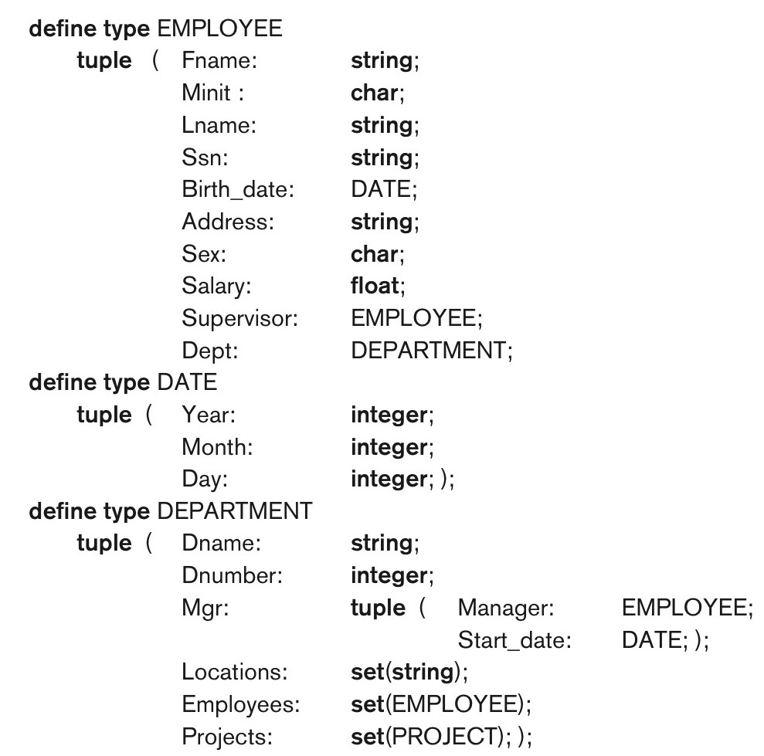
Figure 12.1 Specifying the object types EMPLOYEE, DATE, and DEPARTMENT using type constructors.
Slide 12- 9

Slide 11
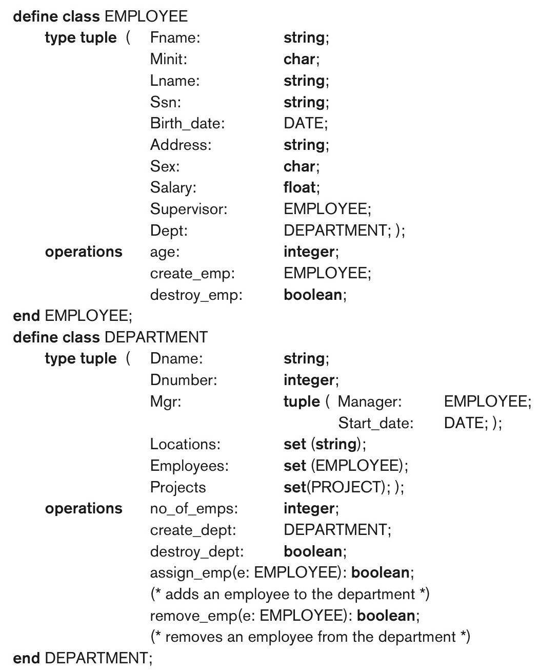
Figure 12.2 Adding operations to the definitions of EMPLOYEE and DEPARTMENT.
Slide 12- 10

Slide 12
Encapsulation of Operations
Encapsulation
  Related to abstract data types
  Define behavior of a class of object based on operations that can be externally applied
  External users only aware of interface of the operations
  Can divide structure of object into visible and hidden attributes
Slide 12- 11

Slide 13
Encapsulation of Operations
Constructor operation
  Used to create a new object
Destructor operation
  Used to destroy (delete) an object
Modifier operations
  Modify the state of an object
Retrieve operation
Dot notation to apply operations to object
Slide 12- 12

Slide 14
Persistence of Objects
Transient objects
  Exist in executing program
  Disappear once program terminates
Persistent objects
  Stored in database, persist after program termination
  Naming mechanism: object assigned a unique name in object base, user finds object by its name
  Reachability: object referenced from other persistent objects, object located through references
Slide 12- 13

Slide 15
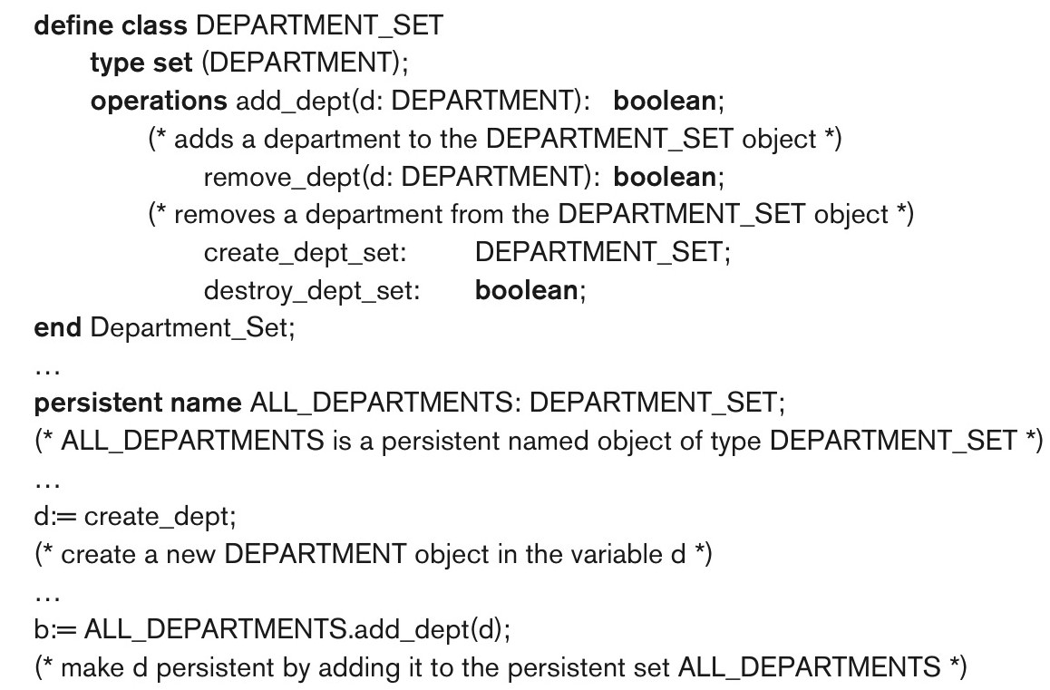
Figure 12.3 Creating persistent objects by naming and reachability.
Slide 12- 14

Slide 16
Type (Class) Hierarchies and Inheritance
Inheritance
  Definition of new types based on other predefined types
  Leads to type (or class) hierarchy
Type: type name and list of visible (public) functions (attributes or operations)
  Format:
    TYPE_NAME: function, function, ..., function
Slide 12- 15

Slide 17
Type (Class) Hierarchies and Inheritance (cont’d.)
Subtype
  Useful when creating a new type that is similar but not identical to an already defined type
  Subtype inherits functions
  Additional (local or specific) functions in subtype
  Example:
    EMPLOYEE subtype-of PERSON: Salary, Hire_date, Seniority
    STUDENT subtype-of PERSON: Major, Gpa
Slide 12- 16

Slide 18
Type (Class) Hierarchies and Inheritance (cont’d.)
Extent
  A named persistent object to hold collection of all persistent objects for a class
Persistent collection
  Stored permanently in the database
Transient collection
  Exists temporarily during the execution of a program (e.g. query result)
Slide 12- 17

Slide 19
Other Object-Oriented Concepts
Polymorphism of operations
  Also known as operator overloading
  Allows same operator name or symbol to be bound to two or more different implementations
  Type of objects determines which operator is applied
Multiple inheritance
  Subtype inherits functions (attributes and operations) of more than one supertype
Slide 12- 18

Slide 20
Summary of Object Database Concepts
Object identity
Type constructors (type generators)
Encapsulation of operations
Programming language compatibility
Type (class) hierarchies and inheritance
Extents
Polymorphism and operator overloading
Slide 12- 19

Slide 21
Object-Relational Features:
Object DB Extensions to SQL
Type constructors (generators)
  Specify complex types using UDT
Mechanism for specifying object identity
Encapsulation of operations
  Provided through user-defined types (UDTs)
Inheritance mechanisms
  Provided using keyword UNDER
Slide 12- 20

Slide 22
User-Defined Types (UDTs) and Complex Structures for Objects
UDT syntax:
  CREATE TYPE <type name> AS (<component declarations>);
  Can be used to create a complex type for an attribute (similar to struct – no operations)
  Or: can be used to create a type as a basis for a table of objects (similar to class – can have operations)
Slide 12- 21

Slide 23
User-Defined Types and Complex Structures for Objects (cont’d.)
Array type – to specify collections
  Reference array elements using []
CARDINALITY function
  Return the current number of elements in an array
Early SQL had only array for collections
  Later versions of SQL added other collection types (set, list, bag, array, etc.)
Slide 12- 22

Slide 24
Object Identifiers Using Reference Types
Reference type
  Create unique object identifiers (OIDs)
  Can specify system-generated object identifiers
  Alternatively can use primary key as OID as in traditional relational model
  Examples:
    REF IS SYSTEM GENERATED
    REF IS <OID_ATTRIBUTE> <VALUE_GENERATION_METHOD> ;
Slide 12- 23

Slide 25
Creating Tables Based on the UDTs
INSTANTIABLE
  Specify that UDT is instantiable
  The user can then create one or more tables based on the UDT
  If keyword INSTANTIABLE is left out, can use UDT only as attribute data type – not as a basis for a table of objects
Slide 12- 24

Slide 26
Encapsulation of Operations
User-defined type
  Specify methods (or operations) in addition to the attributes
  Format:
  CREATE TYPE <TYPE-NAME> (
  <LIST OF COMPONENT ATTRIBUTES AND THEIR TYPES>
  <DECLARATION OF FUNCTIONS (METHODS)>
  );
Slide 12- 25

Slide 27
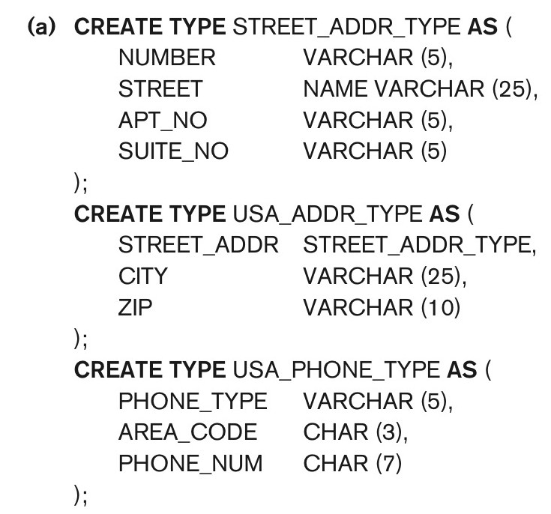
Figure 12.4a Illustrating some of the object features of SQL. Using UDTs as types for attributes such as Address and Phone.
continued on next slide
Slide 12- 26

Slide 28
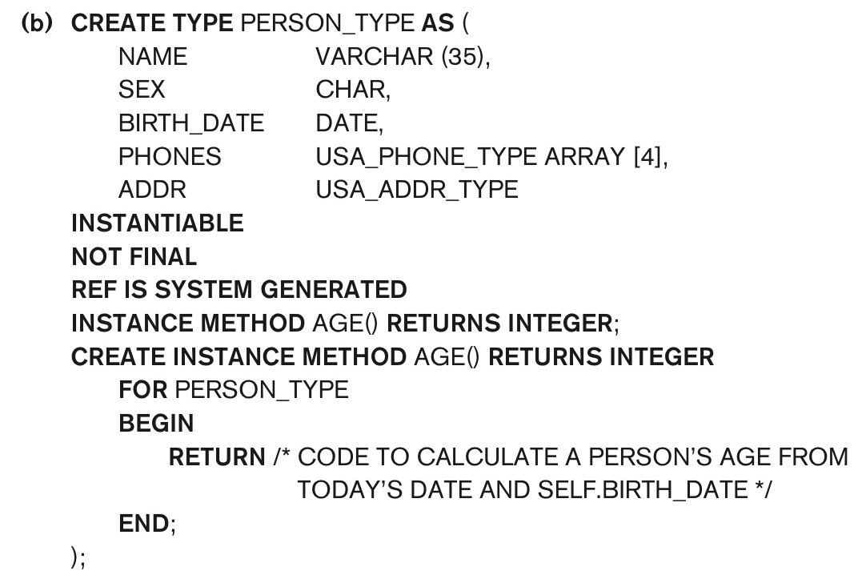
Figure 12.4b Illustrating some of the object features of SQL. Specifying UDT for PERSON_TYPE.
continued on next slide
Slide 12- 27

Slide 29
Specifying Type Inheritance
NOT FINAL:
  The keyword NOT FINAL indicates that subtypes can be created for that type
UNDER
  The keyword UNDER is used to create a subtype
Slide 12- 28

Slide 30
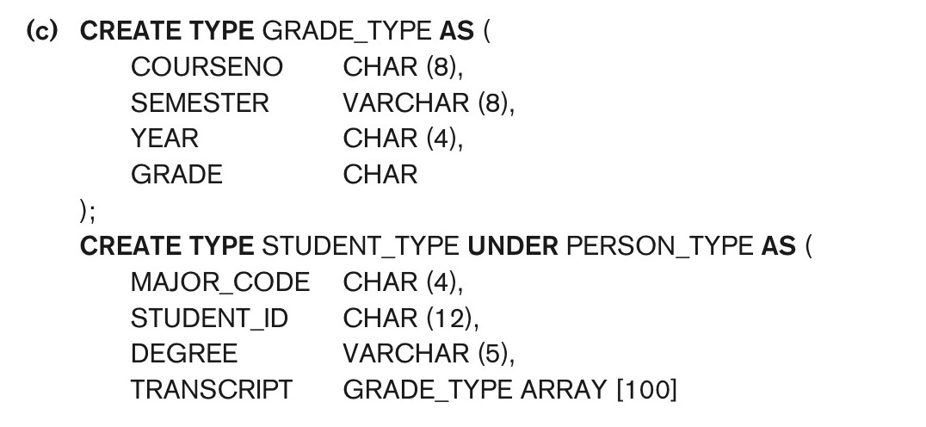
Figure 12.4c Illustrating some of the object features of SQL. Specifying UDTs for STUDENT_TYPE and EMPLOYEE_TYPE as two subtypes of PERSON_TYPE.
continued on next slide
Slide 12- 29

Slide 31
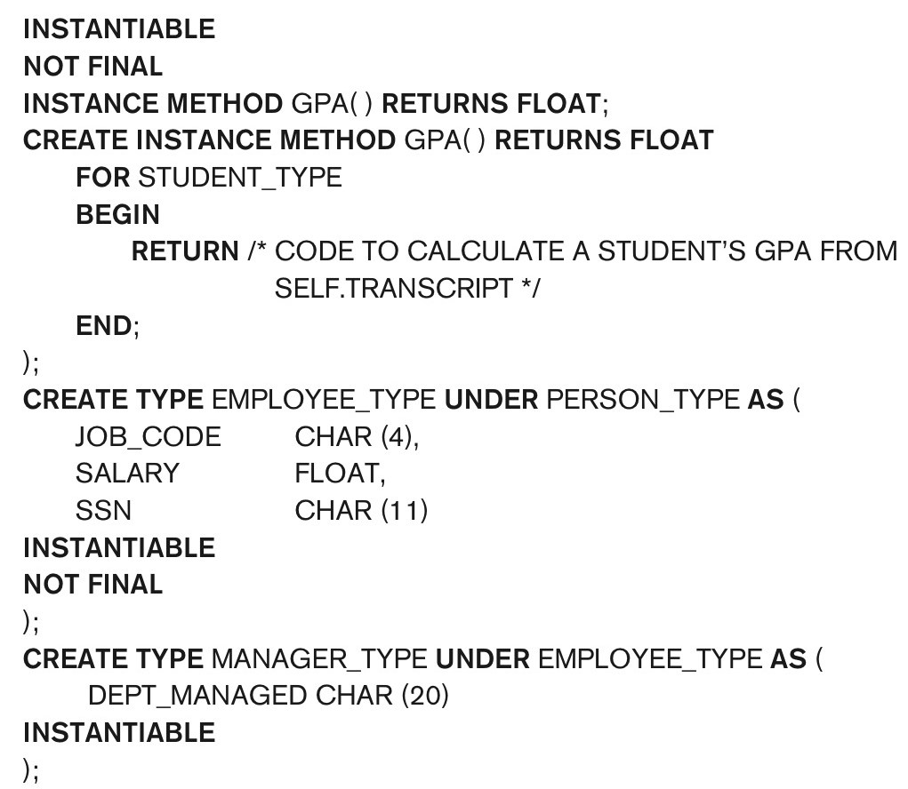
Figure 12.4c (continued) Illustrating some of the object features of SQL. Specifying UDTs for STUDENT_TYPE and EMPLOYEE_TYPE as two subtypes of PERSON_TYPE.
continued on next slide
Slide 12- 30

Slide 32
Specifying Type Inheritance
Type inheritance rules:
  All attributes/operations are inherited
  Order of supertypes in UNDER clause determines inheritance hierarchy
  Instance (object) of a subtype can be used in every context in which a supertype instance used
  Subtype can redefine any function defined in supertype
Slide 12- 31

Slide 33
Creating Tables based on UDT
  UDT must be INSTANTIABLE
  One or more tables can be created
  Table inheritance:
    UNDER keyword can also be used to specify supertable/subtable inheritance
    Objects in subtable must be a subset of the objects in the supertable
Slide 12- 32

Slide 34
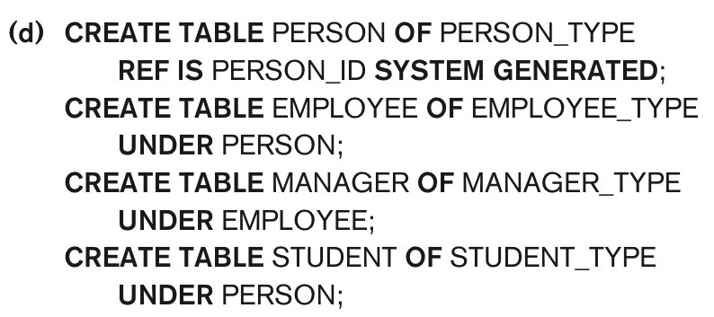
Figure 12.4d Illustrating some of the object features of SQL. Creating tables based on some of the UDTs, and illustrating table inheritance.
continued on next slide
Slide 12- 33

Slide 35
Specifying Relationships via Reference
Component attribute of one tuple may be a reference to a tuple of another table
  Specified using keyword REF
Keyword SCOPE
  Specify name of table whose tuples referenced
Dot notation
  Build path expressions
–>
  Used for dereferencing
Slide 12- 34

Slide 36
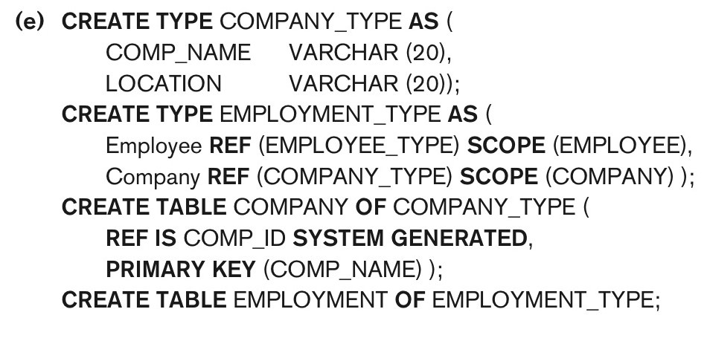
Figure 12.4e Illustrating some of the object features of SQL. Specifying relationships using REF and SCOPE.
Slide 12- 35

Slide 37
Summary of SQL Object Extensions
UDT to specify complex types
  INSTANTIABLE specifies if UDT can be used to create tables; NOT FINAL specifies if UDT can be inherited by a subtype
REF for specifying object identity and inter-object references
Encapsulation of operations in UDT
Keyword UNDER to specify type inheritance and table inheritance
Slide 12- 36

Slide 38
The Object Query Language OQL
Query language proposed for ODMG object model
Simple OQL queries, database entry points, and iterator variables
  Syntax: select ... from ... where ... Structure
  Select D.Dname
  From D in DEPARTMENTS
  Where D.College = ‘Engineering’;
Slide 12- 56

